Slide 1
OOP Rental CD

Slide 2
Nama Kelompok
Ivan Andrianto (F1D018027)
Ida Ayu Vigi MP (F1D018078)

Slide 3

Permasalahan
MERCURY
SATURN
NEPTUNE
MARS
Terdapat tempat peminjaman publikasi video dan music
Peminjam dapat meminjam salah satu / beberapa jenis publikasi
1 Jenis publikasi dapat terdiri dari beberapa copy
Suatu jenis publikasi tidak harus selalu ada yang meminjam

Slide 4
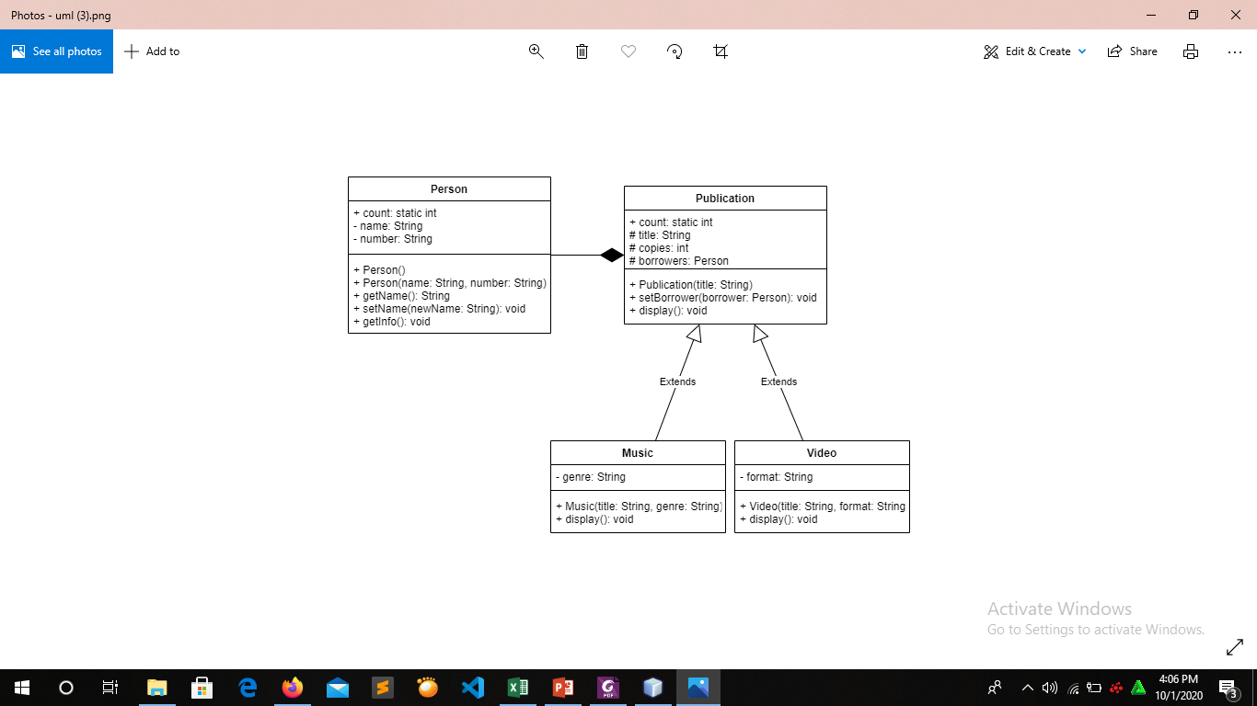
Abstraksi Kebutuhan dan Keterhubungan Kelas

Slide 5
Entitas Person

Slide 6
Entitas Publication

Slide 7
Entitas Musik

Slide 8
Entitas Vidio

Slide 9
Codingan

Slide 10
public class Person { public static int count = 0; private String name; private String number; public Person(){ name = "Unknown"; number = "+6285972700144"; count++; } public Person(String name, String number){ this.name = name; this.number = number; count++; } public String getName(){ return name; } public void setName(String newName){ name = newName; } public void getInfo(){ System.out.println("Name: "+name); System.out.println("Number: "+number); } }
Class Person
10

Slide 11
import java.util.ArrayList; public class Publication { public static int count = 0; protected String title; protected int copies = 0; protected ArrayList<Person> borrowers = new ArrayList<>(); public Publication(String title){ this.title = title; count++; } public void setBorrower(Person borrower){ borrowers.add(borrower); copies++; } public void display(){ System.out.println("Terdapat "+copies+" peminjam \""+title+"\" yaitu: "); for(Person x: borrowers){ System.out.println(x.getName()); } } }
Class Publication
11

Slide 12
public class Music extends Publication { private String genre; public Music(String title, String genre){ super(title); this.genre = genre; } @Override public void display(){ System.out.println("Terdapat "+copies+" peminjam \""+title+"("+genre+")\" yaitu: "); for(Person x: borrowers){ System.out.println(x.getName()); } } }
Class Music
12

Slide 13
public class Video extends Publication { private String format; public Video(String title, String format){ super(title); this.format = format; } @Override public void display(){ System.out.println("Terdapat "+copies+" peminjam \""+title+format+"\" yaitu: "); for(Person x: borrowers){ System.out.println(x.getName()); } } }
Class Vidio
13

Slide 14
public class Quiz { public static void main(String[] args) { Music peterpan = new Music("Koleksi Lagu Peterpan", "Pop"); peterpan.setBorrower(new Person("Haidar", "081907098765")); peterpan.setBorrower(new Person("Mae", "081917098765")); peterpan.display(); System.out.println(); Video ngoding = new Video("Belajar Algoritma dan Pemrograman", ".mp4"); Video maumere = new Video("Senam Maumere", ".3gp"); maumere.setBorrower(new Person("Tipong", "081907099765")); maumere.setBorrower(new Person("Cita", "081907097765")); maumere.setBorrower(new Person("Desy", "081907098865")); maumere.display(); System.out.println(); System.out.println("Jumlah publikasi: "+Publication.count); System.out.println("Jumlah peminjam: "+Person.count); } }
Class Quiz
14

Slide 15
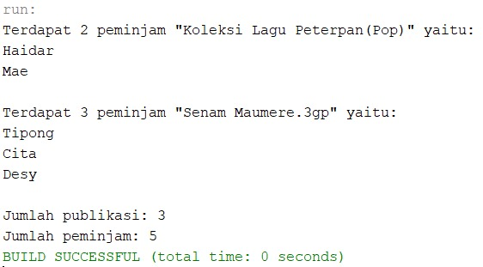
Hasil Run
OOP Rental CD

Slide 16
Thanks!

